Slide 1
DEEP LEARNING (IT549) INTRODUCTION
Bakul Gohel, Ph.D.
DA-IICT, Gandhinagar

Slide 2
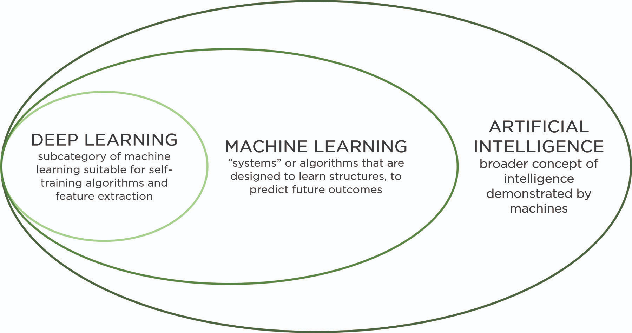
Deep Learning

Slide 3
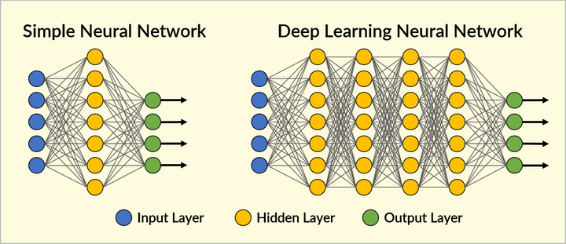
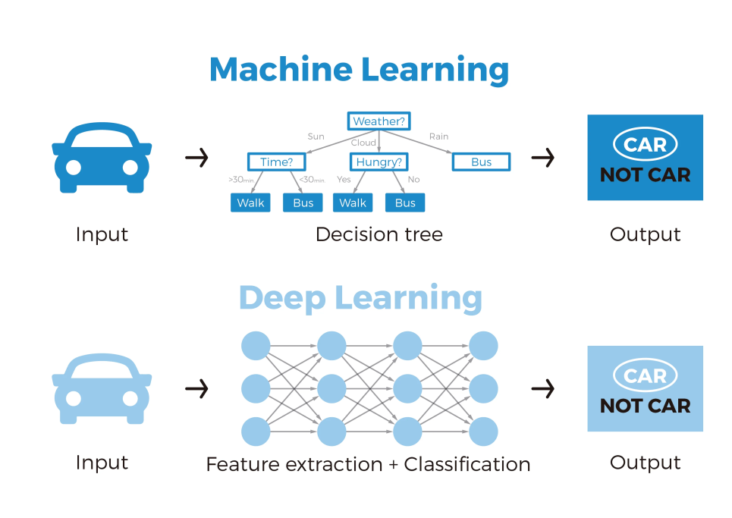
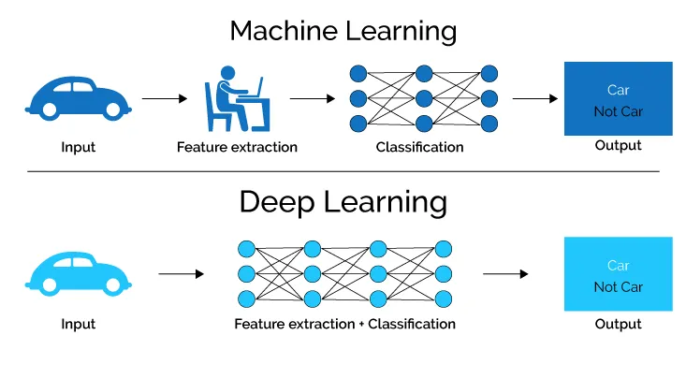
Deep ? Learning

Slide 4

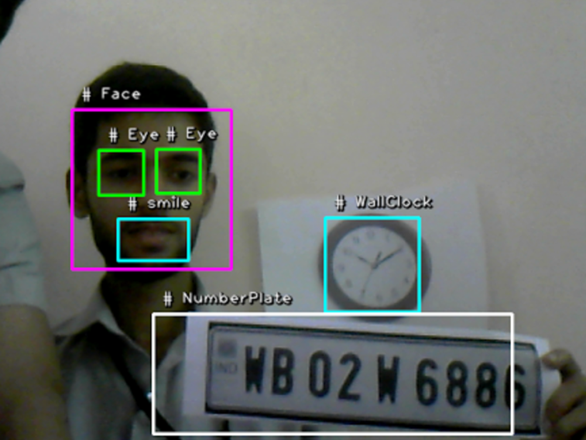


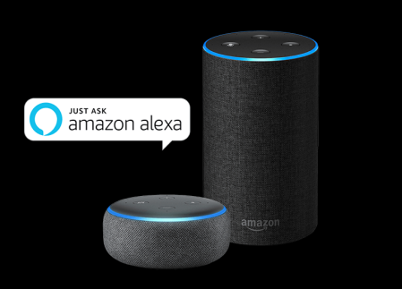
Why DEEP LEARNING ?
Why DEEP LEARNING ? Solve…
: Object detection and recognition
: Natural language processing / speech to text / speech recognition

Slide 5
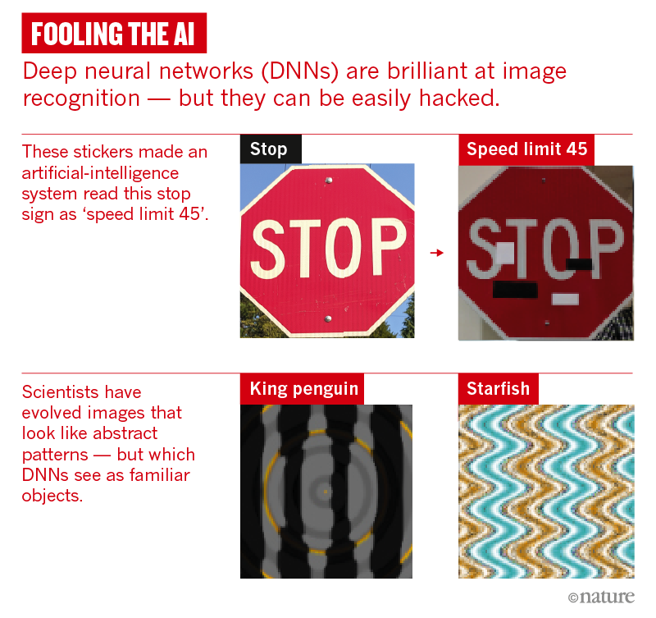
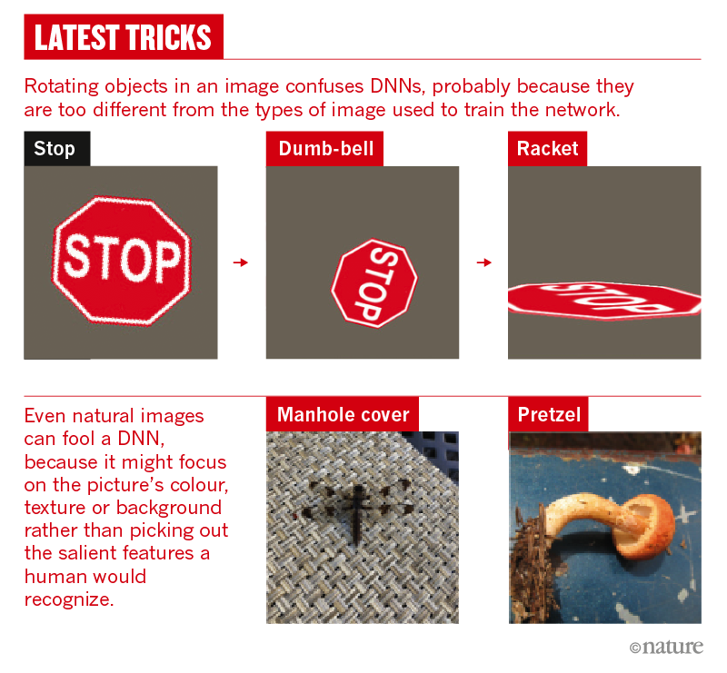

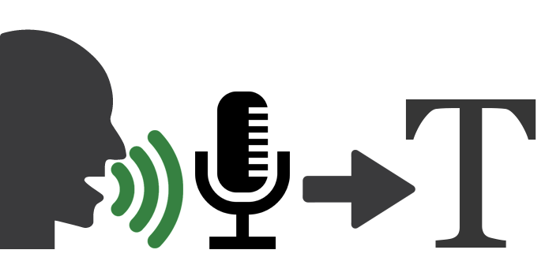
Scope
OPEN CHALANGEs / PROBLEMs for DEEP LEARNING :
: Object detection and recognition
: Natural language processing / speech to text / speech recognition

Slide 6

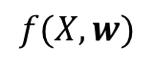
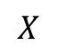
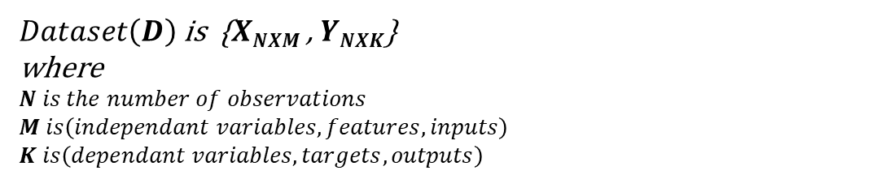

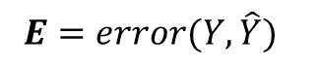
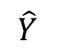

Machine Learning
$Dataset\left(D\right)$ is {$XNXM$ , $YNXK$}
where
$$N is the number of observations$$
$$M is\left(independant variables, features, inputs\right)$$
$$K is\left(dependant variables, targets, outputs\right)$$
Model
Input
Output
$$E=error(Y,\hat{Y})$$
$$X$$
$$\hat{Y}$$
$$f(X,w)$$
$$find w (parameters) that minimize the prediction error(E)$$
Learning : learn mapping function $f:ℝ^{M}→ℝ^{K}$ given dataset $D$
Prediction: $\hat{Y}$ = $f(\hat{X})$, generaly $\hat{X}$ is not belong to training data $D$, but expected to follow distribution similar to $X$

Slide 7
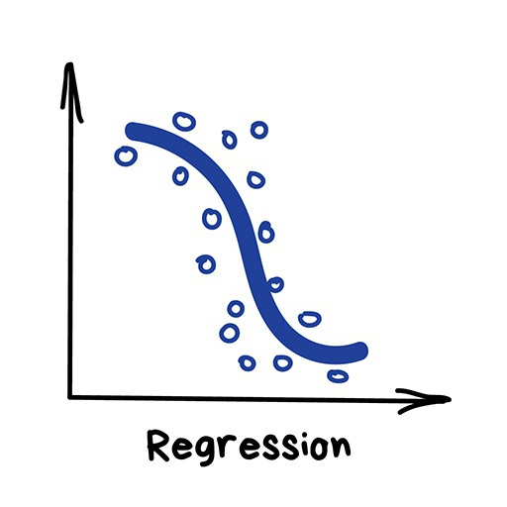
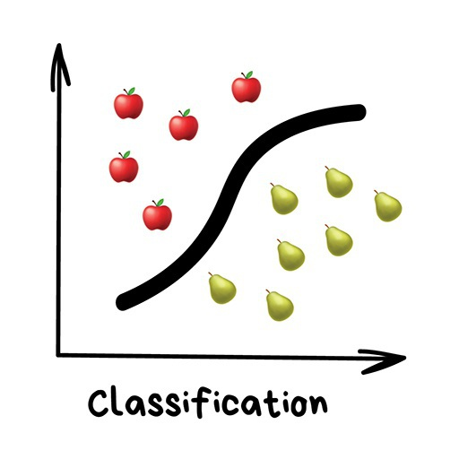
Supervised Machine Learning
During the training of the model, input and corresponding output is known, and error in predicting output value guide the model learning…
Regression
Classification

Slide 8
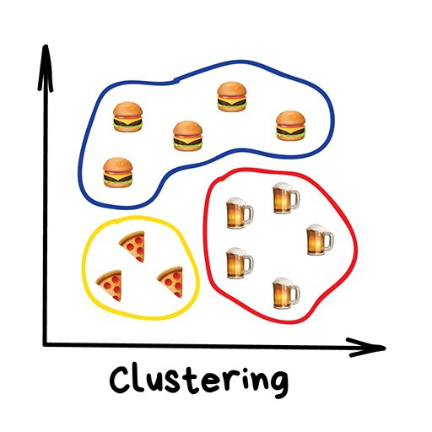
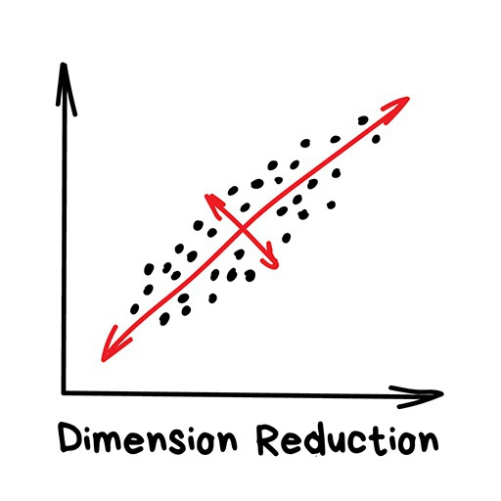
Unsupervised Machine Learning
learn the input data distribution or its structural characteristics
Clustering
PCA and ICA

Slide 9
Lets do

